Slide 1
From Intrastat to SIMSTAT and ESS.VIP Programme
Walter Radermacher
ESTAT

Slide 2
Modern design of Statistics = multiple sources, multimode data collection, enhanced quality
Principles:
re-using existing data and compiling different data sources before going for surveys
if the survey is run, the most modern technologies should be used
statistical quality should be ensured with moving validation as early as possible into the production chain
Walter Radermacher
ESTAT

Slide 3
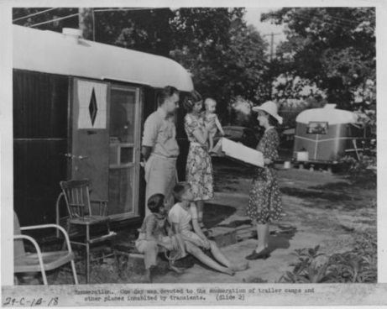
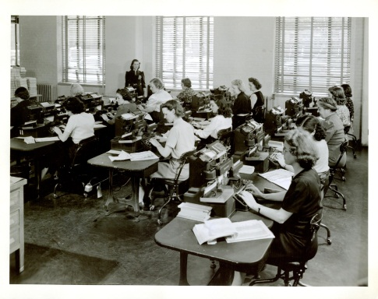
Modern design of statistics example Census
Combines different sources: administrative registers, geographical data, sample survey data
Employs mixed mode data collection (CAWI, CATI)
Uses output quality orientation with emphasis on the validation at the beginning of the production chain
Walter Radermacher
ESTAT

Slide 4
Transition problems: Census
Risks of the new model:
Complexity
Acceptability
Lack of control
Degree of abstraction
Uncertainty (if sampling used)
Dependency from administrative sources

Slide 5
Why analogy with Census 2011?
Intrastat is a census-type statistical survey, carried out monthly and covering both import and export
Intrastat is an expensive survey generating around 50% of the administrative burden from official statistics
Similar risks plus cross-border risk components
Walter Radermacher
ESTAT

Slide 6
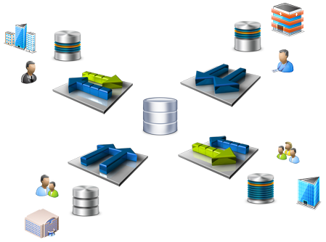
SIMSTAT project
A modern multiple source / mixed mode design of trade statistics
The first domain for implementing exchange micro data for statistical purposes;
Walter Radermacher
ESTAT

Slide 7
SIMSTAT = principles of modern design of trade statistics
Re-uses available information (by making micro-data on export of other MS available)
Thus:
opening up the possibility of gradually replacing the import survey by other sources
providing opportunities for improving quality of import flow, i.e. through using as far as possible sampling surveys for quality assurance
Walter Radermacher
ESTAT

Slide 8
SIMSTAT: first application of the ESS.VIP Programme principles
Exchange of micro-data requires:
Walter Radermacher
ESTAT

Slide 9
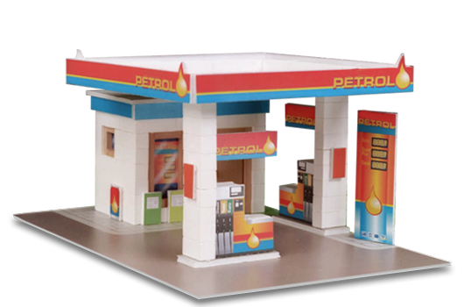
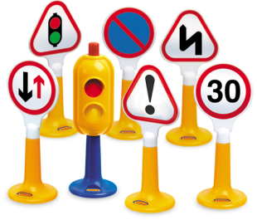
Physical Networks such as EDAMIS, CCN-CCI;
Shared services accompanying data exchange;
Application software and hardware at both national and European level;
Standards for data exchange (SDMX and DDI) and appropriate legal frameworks.
Walter Radermacher
ESTAT

Slide 10
Where are we one year later?
Results from Phase 1 of the project: feasibility study:
Consensus on the centralised hub based system for micro-data exchange;
Identified options for infrastructure (EDAMIS, CCN/CCI).
Lessons learned and difficulties to overcome:
Confidentiality issues related to microdata exchange;
Mutual trust among ESS partners.
Walter Radermacher
ESTAT

Slide 11
The main challenge at this stage
Ensuring that the solutions chosen for SIMSTAT will be reusable by the other statistical domains, business ESS.VIPs respectively while the roadmap for SIMSTAT is respected;
Walter Radermacher
ESTAT

Slide 12
What is ESS.VIP and why?
Integrated production system ("back office")
Exchanging micro data and using them for compiling statistics
Reduce redundancies and duplications in data validation procedures
Standardised and shared services, supported by common IT tools
Elements of the computing resources (e.g. networks, servers, storage, applications and services) be safely shared through cloud computing and thus reduce the investments and maintenance costs
Part of the ESS system (i.e. one or a limited number of NSIs) perform a service for the rest acting as a Centre of Competence
Conditions in terms of legal and financial frameworks
Walter Radermacher
ESTAT

Slide 13
Structure of the programme
Pillar I: Cross-cutting projects (ESS.VIP.CRC). These projects aim at developing key building blocks of the common infrastructure for a more integrated ESS in the future. The following four projects are components of this pillar (Standards and Information models, European Statistical Data Exchange Network, Shared services, Data Warehouses).
Pillar II: Business projects (ESS.VIP.BUS). These projects focus on individual statistical domains. Seven projects are considered to be elements of this pillar of which three were launched in 2012 (SIMSTAT, Common Data Validation Policy, ESBRs). One new project will be proposed for endorsement by the ESSC in May 2013, namely the ICT – Statistical production and dissemination based on shared services and four other are still in preparation with active participation of the MS.
Pillar III: Administrative projects (ESS.VIP.ADM). These projects aim at defining the governance of the system, the actors, their responsibilities, the resources committed, the administrative mechanisms, the implementation strategy and the associated communication.
Walter Radermacher
ESTAT

Slide 14
Thank you for your attention!
Walter.Radermacher@ec.europa.eu
http://ec.europa.eu/eurostat
ESTAT

